Slide 1
Machine Learning 2 -
Housing Price &
Drinking Behaviour
Zahra Eshtiaghi (476679)
Tsoi Kwan Ma (476914)

Slide 2

House Prices Regression (Problem & Data)
Goal
Predict each home's SalePrice from house attributes.
I train on labeled homes and generate predictions for the Kaggle test set.
Dataset snapshot:
• train.csv: 1460 rows × 81 columns (includes target SalePrice)
• test.csv: 1459 rows × 80 columns (no SalePrice)
• Explanatory variables: 79
• Mix of numeric + categorical features
• Train/Validation split used in the notebooks (80/20):
- X_train: 1168 × 80
- X_val : 292 × 80
Evaluation metric
RMSE on log(SalePrice) → “log-RMSE / RMSLE-style”.
Why: house prices are skewed; log makes errors more relative than absolute.
I model in log-space
...then convert back for final submission.

Slide 3
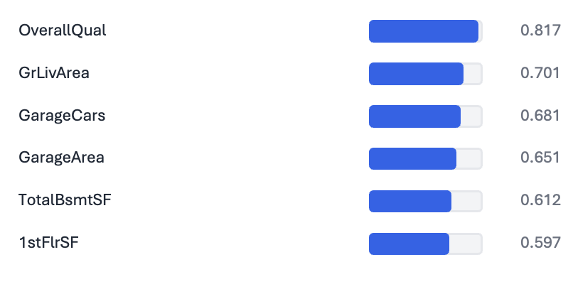
Workflow Overview
How the work is split across 3 notebooks
1) Preprocessing
2) Feature engineering
3) Modeling
Missing values + types
Skewness handling
Encoding + scaling
Save prepared_data.pkl
Correlation checks
Fix encoding issues
Create new features
Save engineered dataset
LASSO feature selection
Train (XGB/LGBM/Cat/RF/Ensemble)
Compare + validate
Create submission file
Top numeric predictors (corr with log SalePrice)
Engineered features (examples)
I added 12 engineered features (age, totals, interactions, ratios).
A few of the strongest new features by |correlation|:
HouseAge (|r|≈0.421)
RemodAge (|r|≈0.420)
GarageAge (|r|≈0.269)
TotalPorch (|r|≈0.202)
Result: richer signals before modeling.
Sanity checks (example)
CentralAir initially showed a negative correlation.
I checked value counts + mean price by category,
then flipped the encoding so “1 = has AC”.
After the fix, correlation became positive (as expected).
Notebooks: 1- regression.ipynb • 2- regression.ipynb • 3-regressionC.ipynb
Notes:
[Talk track]
• Quick map: what each notebook does.
• The key idea is modular + reproducible: I can iterate on modeling without redoing preprocessing.
[Sources]
• (Project work; no external sources for this slide.)

Slide 4
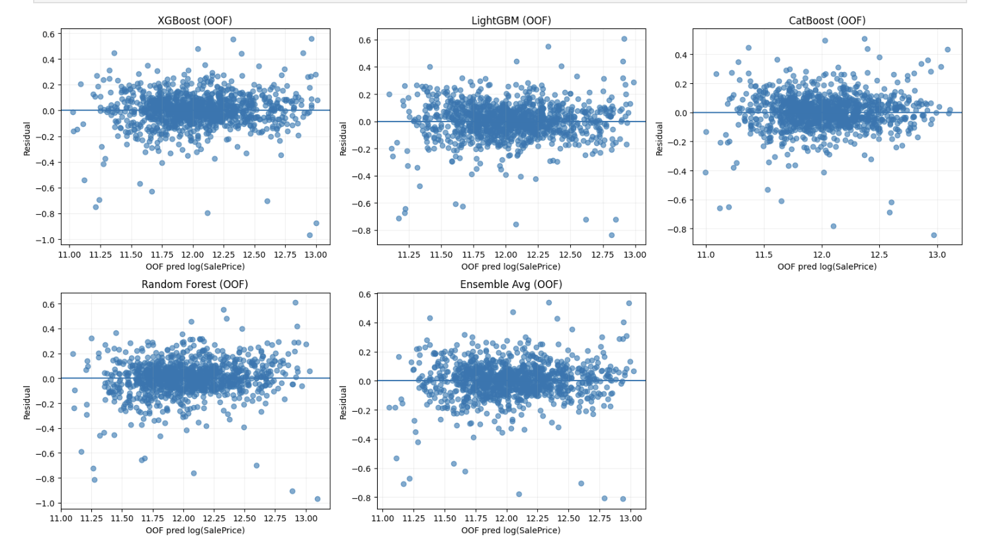
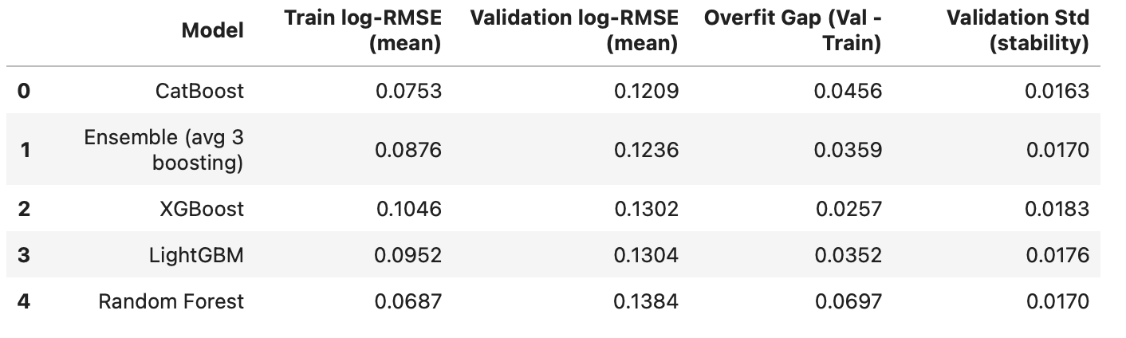
Modeling Results
LASSO feature selection + boosting models
Modeling approach (Notebook 3)
Residual plots (OOF 5-Fold)
Prepared + engineered features
LASSO feature selection
Training five models: XGBoost, LightGBM, CatBoost, RandomForest, Ensemblig Avg3boosting models
Train vs validation (mean)
Predict log(SalePrice) → XGBosst
Model
Train
Val
Gap
XGBoost
0.1046
0.1302
0.0256
Best tuned CV log-RMSE: 0.1243
LightGBM
0.0952
0.1304
0.0352
CatBoost
0.0753
0.1209
0.0456
Notebook 3: LASSO feature selection • tuned boosting models • final submission
Notes:
[Talk track]
• Notebook 3 is the modeling stage: I use LASSO to shrink/select features, then train boosting models.
• On my validation comparison, CatBoost had the best mean validation log-RMSE (≈0.1209).
• The table also shows the overfit gap (val − train) to sanity-check generalization.
[Sources]
• https://www.kaggle.com/competitions/house-prices-advanced-regression-techniques

Slide 5
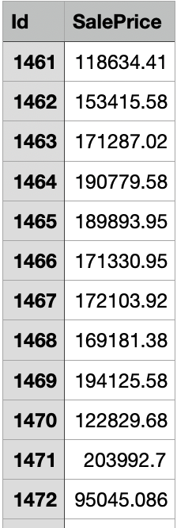
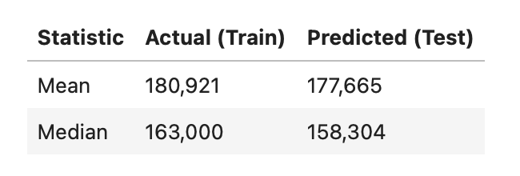
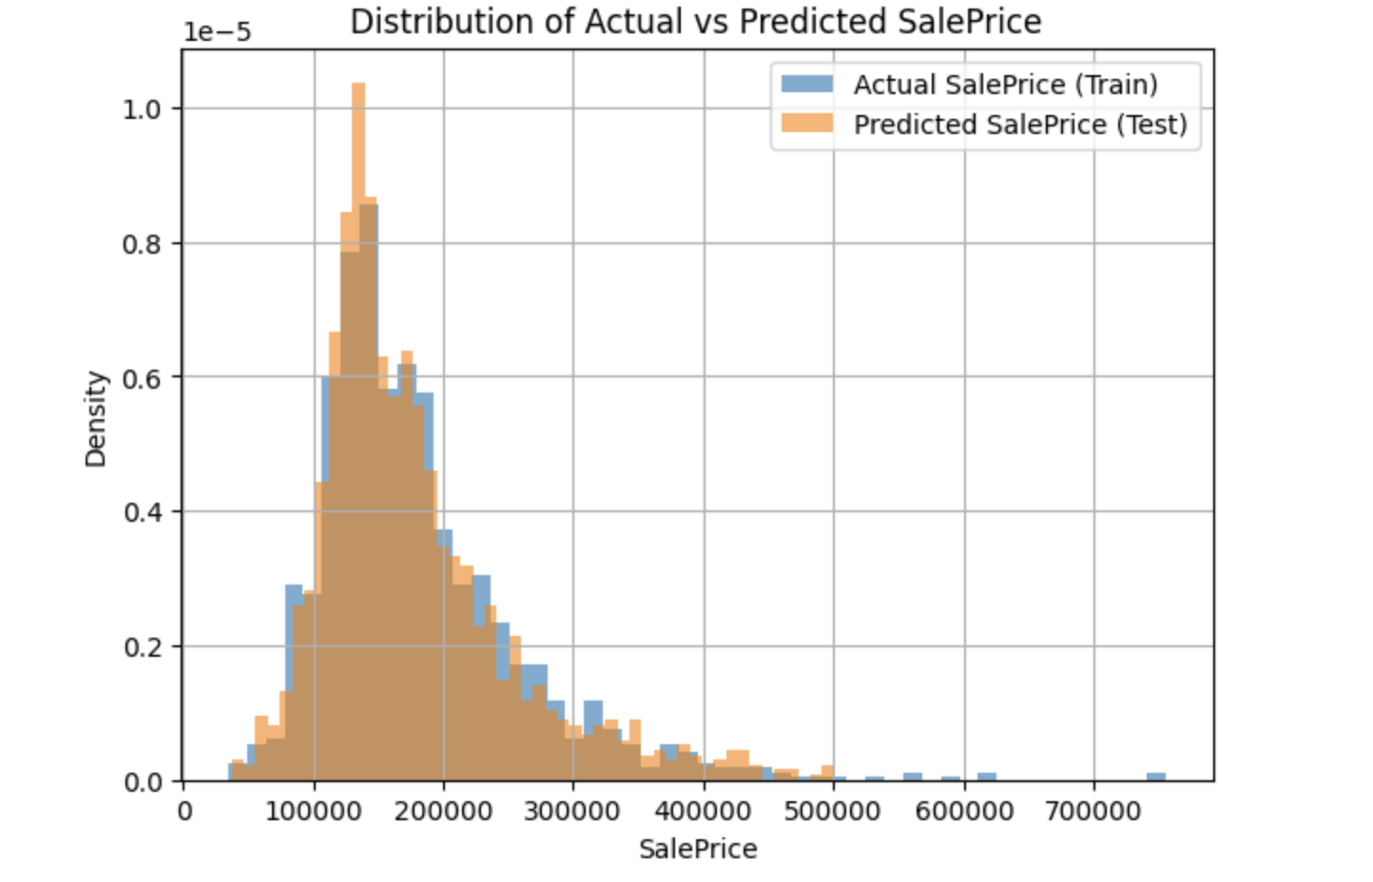
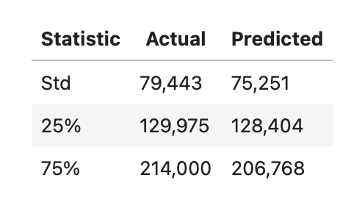
Results and final model
Why Xgboost?
Smallest overfit gap(val – train) across folds
Stable performance vs Catboost/ Ensemble
Residual plots looked more compact/ centerd
Final outpoot: textprediction_xgboost.csv
Actual prices go up to ~755,000 Predicted prices go up to ~500,000
This shows that the model avoids extreme predictions. This is a sign of controlled overfitting, not a mistake.
In real applications, it is usually better to:
slightly under-predict extreme values than to overfit noise.

Slide 6
Classification - Drinking Behaviour
Objective: Predict drinking behaviour (Yes / No) using various body signals (e.g. blood pressure / liver enzymes)
Data: National Health Insurance Service in Korea
Train: 594,807 rows (60%)
Validation: 198,269 rows (20%)
Test: 198,270 rows (20%)
To avoid data leakage, data split done beforehand
Total observations: 991,346
Total columns: 24 (including target variable)
Data Preprocessing & EDA
No missing values
Balanced target distribution (49 / 51)
Lots of outliers on numeric features so abnormally distributed + highly skewed
Feature Selection & Engineering
Spearman correlation (ordinal & numeric)
ANOVA (target with numeric features)
Cramér’s V (target and nominal variables)
Log transformation on skewed numerics
Evaluation Metrics on Models
ROC-AUC: whether well-separate between drinkers and non-drinkers across all thresholds
BA: assess performance at fixed threshold while ensuring equal importance of both classes

Slide 7
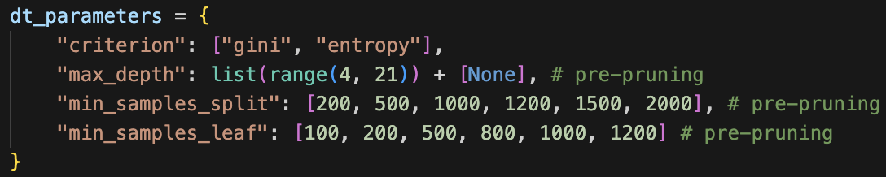
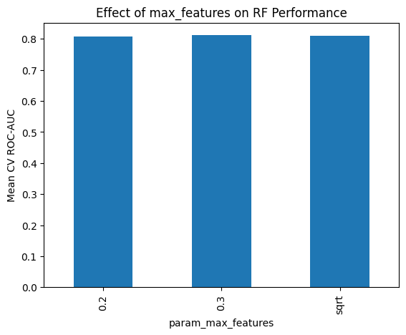
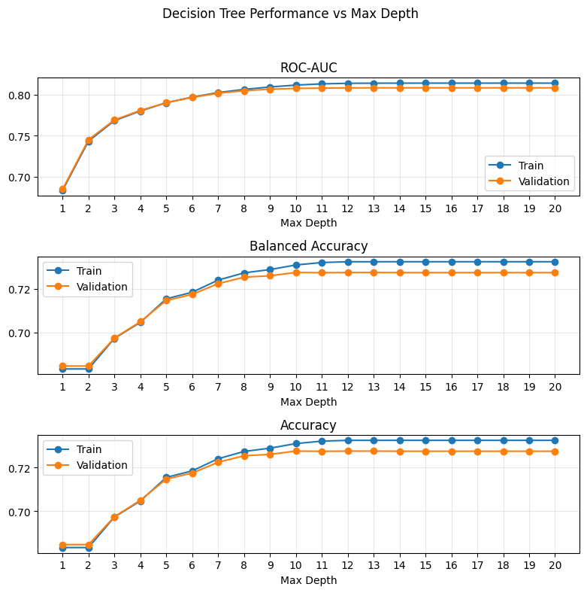
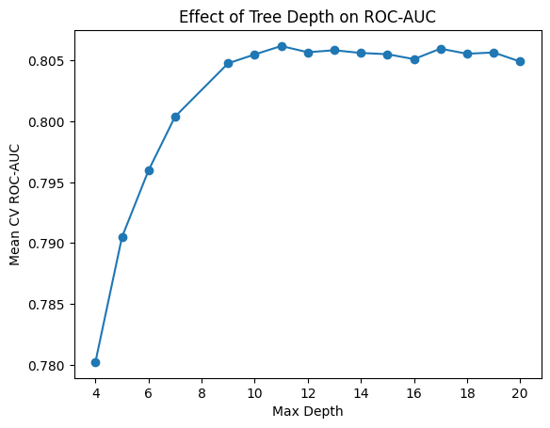
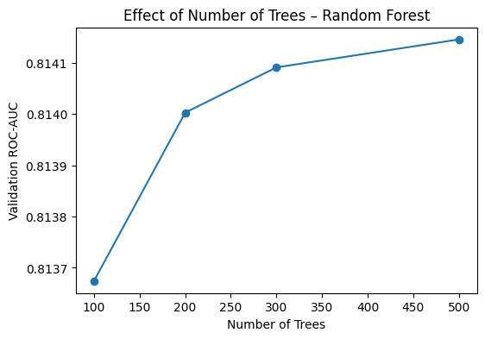
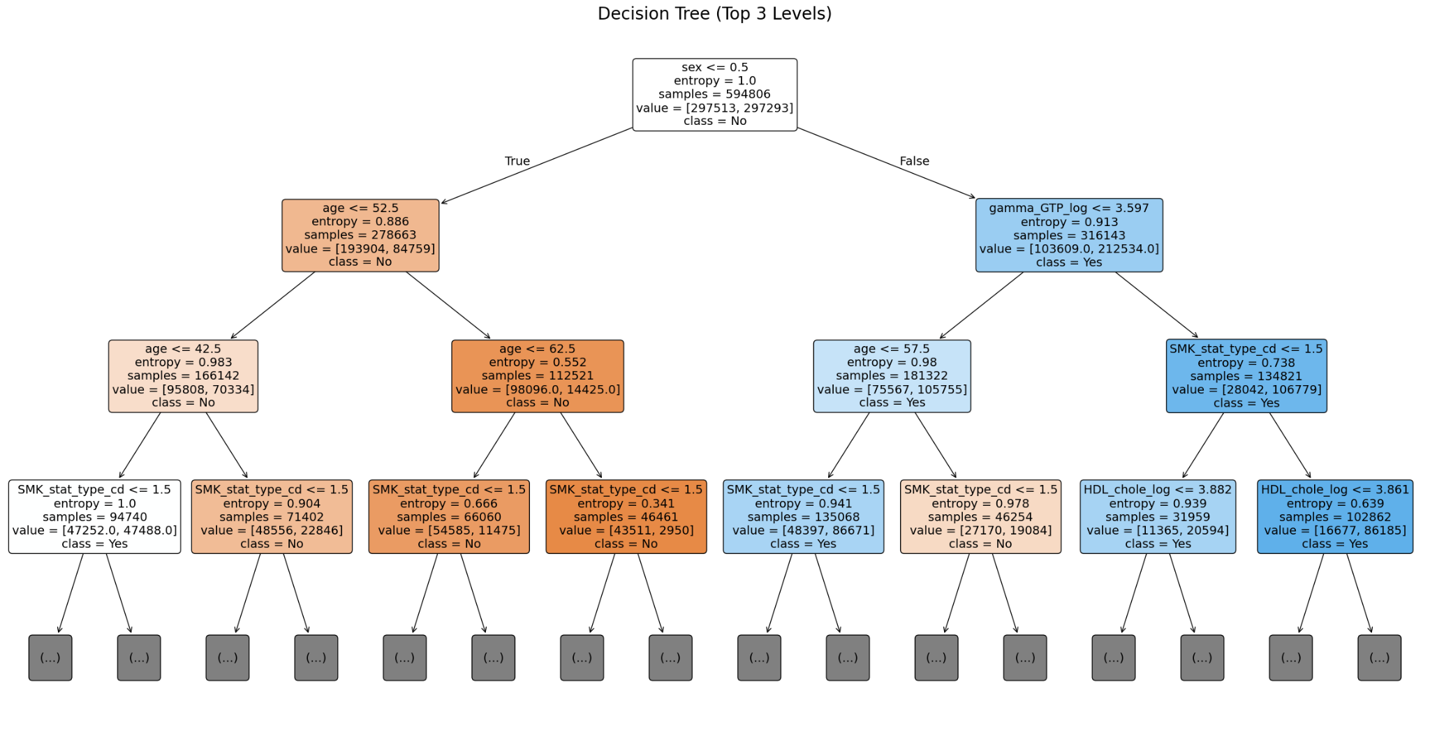
Model Training
Classification Decision Tree (Baseline - CART)
Random Forest (subsample ~ 200k)
OOB (ROC-AUC): 0.7325

Slide 8
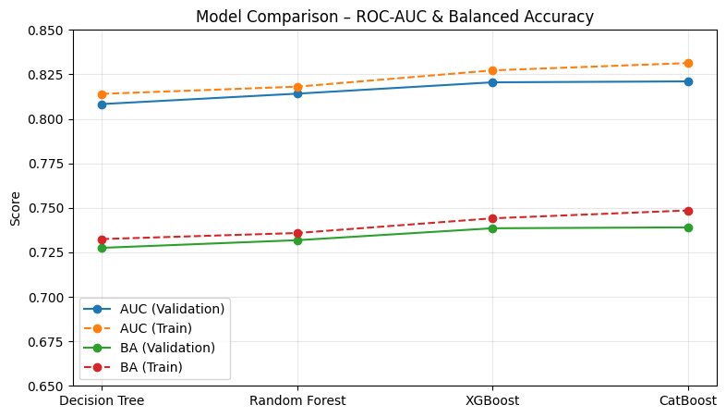
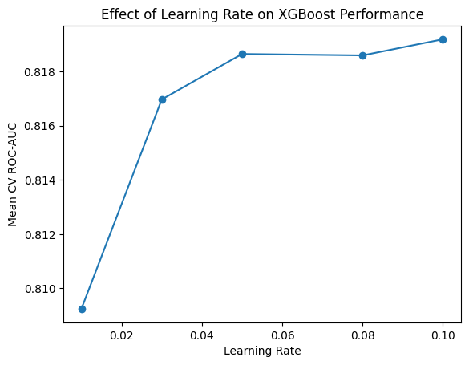
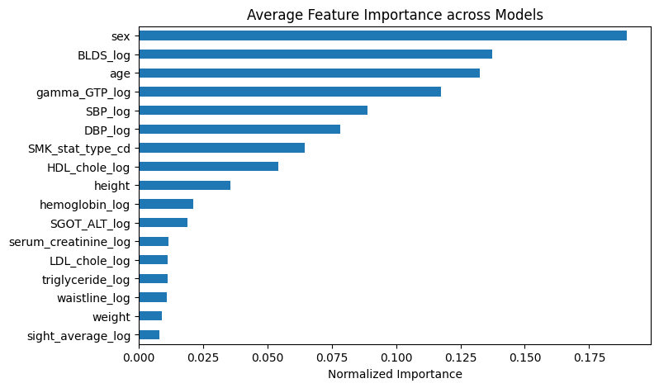
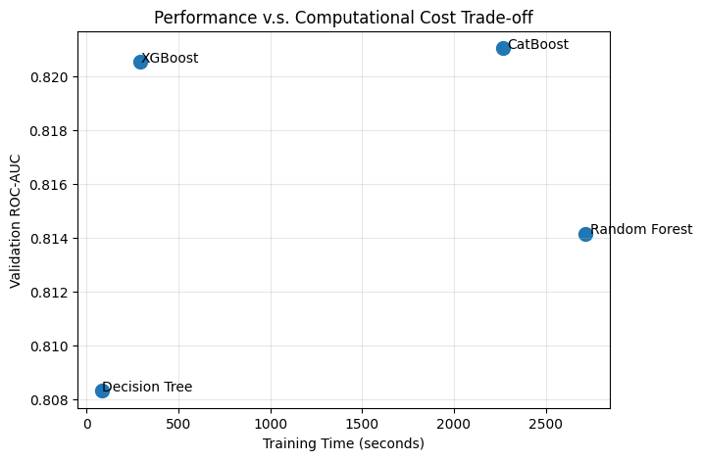
Model Training & Evaluation
XGBoost / CatBoost

Slide 9
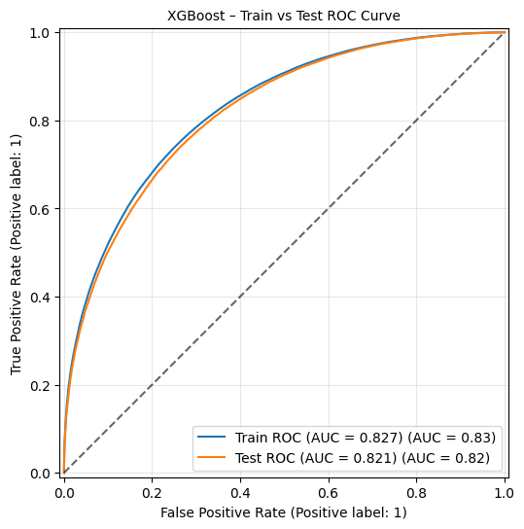
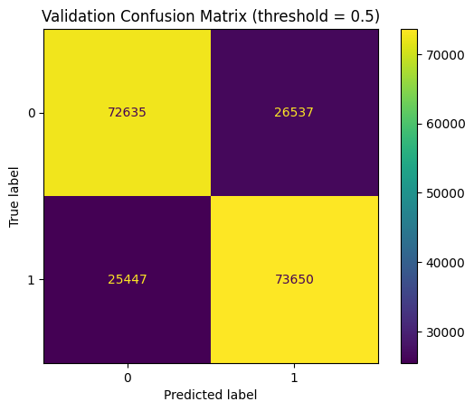
Model Final Test - XGBoost
TRAIN - ROC-AUC: 0.8272, Balanced Acc: 0.7441, Acc: 0.7441, Prec: 0.7411, Recall: 0.7502
TEST - ROC-AUC: 0.8199, Balanced Acc: 0.7378, Acc: 0.7378, Prec: 0.7351, Recall: 0.7432

Slide 10
The End

